Slide 1
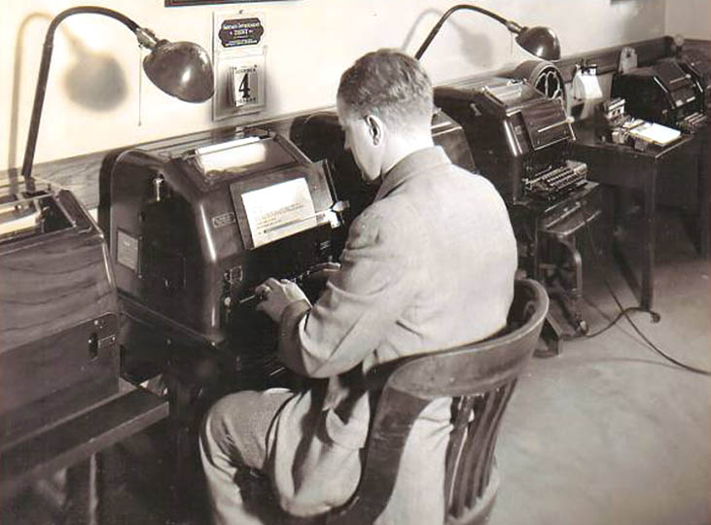
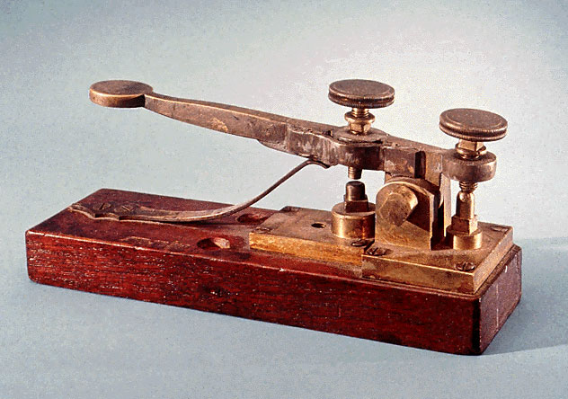
Technology Investigation
By: Taylor Wilson & Emmanuelle Tamayo
The Telegraph
(- .... . - . .-.. . --. .-. .- .--. ....)
GTT Project 1.1.3a

Slide 2
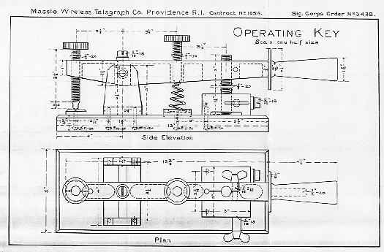
The Telegraph Functions
Purpose:
To send messages faster than previous systems of communication.
Functions:
A telegraph works by sending messages through wires using electrical signals.

Slide 3
Telegraph vs. Email
Telegraph
Email
Takes longer to send a message
Has to be decoded
Must be delivered by messenger
Convenient
Electronically submits your message
Provides almost instant receipt of message

Slide 4
Innovation for Improvement
Expanding the wire network available was the biggest innovation in telegraphy allowing messages to be sent nationwide and over seas. Eventually, the telegraph was adapted to send photos and pictures. Making the telegraph a early relative to the telephone and fax machine.

Slide 5
Types Invented
Optical Telegraph: Smoke signals, Beacon
Oceanic Telegraph: Allowed for telegraphs to be sent over seas

Slide 6
Positive Impact of Invention
Easier to communicate
Basis for modern telecommunications
Important news traveled faster

Slide 7
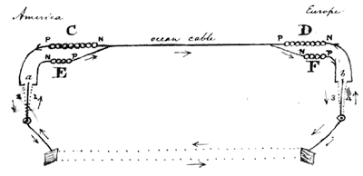
Inventor, Date and Invention Details
Inventor and date: Samuel Finley Breese Morse, 1835
Invention details: Buttons; Used for typing messages | Send button; Used to send the messages to people

Slide 8
Quote about the Invention
Quote: “What hath God wrought?” -Samuel F.B. Morse
First Message Sent

Slide 9
Types of Inventions
Electrical:
The electric telegraph is a communication system that transmitted electric signals over wires from location to location and translated a message. William Sturgeon invented the electric telegraph in 1825. It was further develop by Joseph Henry in 1830, Charles Wheatstone in 1837 and Samuel Morse in 1835.
Non-Electrical:
The non-electric telegraph was invented by Claude Chappe in 1794. This system was visual and used semaphore, a flag-based alphabet, and depended on a line of sight for communication. The optical telegraph was replaced by the electric telegraph.

Slide 10
Technology of Invention
Telegraph is considered as the beginning of the technology invention in communication.

Slide 11
Overview of the Creation
Example | Science | Technology | Engineering | Math
The Telegraph | Used existing knowledge of electricity | -What is being used to build: Wires, buttons, codes, buzzer, battery, transmitter | Used electro magnets, set the first telecommunitons wiring along railroads. | -The height -The length
Telegraph is considered as a technology. Any technology used or invented it involves math in general. They designed them to work properly using formula and it cost money to do it.

Slide 12
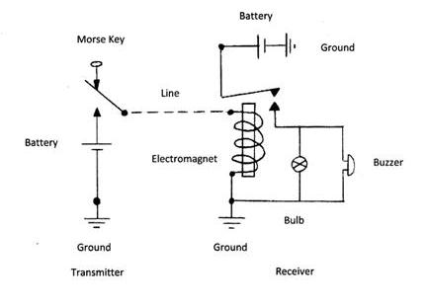
Negative impact on Society
The negative impact of the telegraph to the society is that telegraph company increased and competition became so strong that ends up the telegraph service very bad and it was sent poorly or to different location. Sometimes the message was lost at all.

Slide 13
Resources
http://www.brainyquote.com/quotes/keywords/telegraph.html
http://www.enchantedlearning.com/inventors/indext.shtml
http://inventors.about.com/od/tstartinventions/a/telegraph.htm
http://eh.net/encyclopedia/article/nonnenmacher.industry.telegraphic.us
http://communication.howstuffworks.com/history-of-fax1.htm
http://www.enchantedlearning.com/inventors/
http://www.madere.com/firstnet.htm

