Slide 1
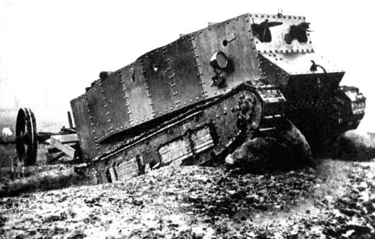
Technology Investigation
By: Adriel Castro
Armored Vehicles-Tank
GTT Project 1.1.3a

Slide 2
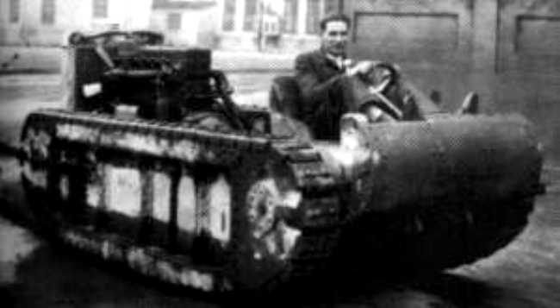
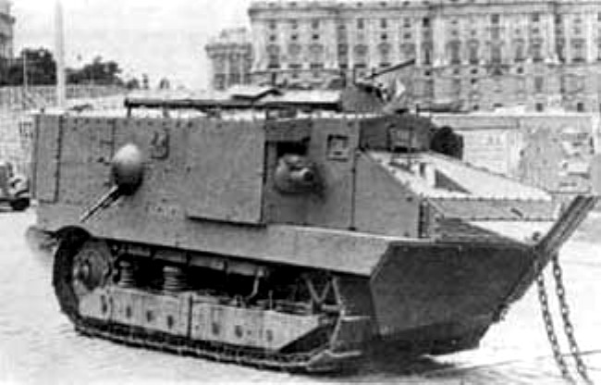
Technology Investigation
By: Jaden Patel
Tank
GTT Project 1.1.3a

Slide 3
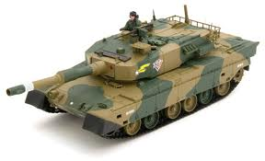
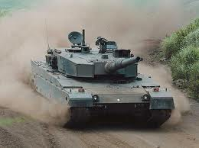
History
Main Functions:
Caterpillar Tracks, Internal Combustion Engine, Hull, Turret, Armor, Guns
The First Purpose of the Tank was to be able to get to the side of the enemy in wars and or battles to attack. It was also used to go in and over enemy areas

Slide 4
History
Purpose
Main functions
The two missiles on the top ,the armor on continues tracks the hatch to go in and out and the main sheet of armor on the tank.
To fight in battles ,wars, combat and machinery used to destroy enemy battle ground .

Slide 5
Title of Slide
British Army, 1916 (No Individual Person) inspired by Richard Edgeworth’s Caterpillar Tractor
Invention Details: The Idea Of The Tank was inspired by Richard Edgeworth Invention of the Caterpillar Tractor which gave attention to The British Army around the 1900’s. The British thought of a Tractor like that can travel through ground like ( mud, dirt, etc.) except covered with armor they could cross and go over into enemy trenches and still survive. So they passed the idea to the government and was passed of as a project. The Original Tanks were not used until the end of 1916 but did not work out because the tanks were breaking down until the army saw the great potential of the tanks also and got to work with it and year later successfully they worked perfectly and worked on November 17, 1917

Slide 6
Inventor Information
Inventor and date: General Creighton
Invention details: The “tank "was not the first military use the first was a tractor but just adding guns, canons and armor just made it better.

Slide 7
Original vs Today
Original : Armored Tractor, Caterpillar Tracks, internal combustion engine, 2 revolving machine guns, bulletproof casing, turret
Today: Gas Turbine Engines, Digital Fuel control system, Improved Armor, automatic hydrokinetic transmission, Cannons, explosive firepower, turret, fire control system, penetrating armor ammo

Slide 8
Original vs. Today
Original :The original was very complex meaning it did not have all the new fetchers 'that we have on the now a day m1 tank.
Today: Today our m1 tanks have all the armor and military that we need to survive any combat battle .

Slide 9
Quote about the Invention
Quotes : “ If the tanks succeed, then victory follows.”
-Heinz Guderian
“Our country is not in crisis; there are no tanks in the streets. No matter what the outcome of the president's situation, life in America will go on. Our lives will continue to be filled with practical matters, not constitutional ones.”
-Jennifer Dunn
“Tanks come in two forms: the dangerous, deadly kind and the "liberating" kind.”
- Robert Fisk

Slide 10
Quote about the Invention
Quote: “if the tanks succeed then victory follows” by: Heinz Guderian
Quote:”the tanks come in two forms :deadly kind and the “liberating kind”. by: Robert fisk

Slide 11
Innovations for improvement
Tanks Should Have Heat-Seeking Camera That Shows any enemies around inbound by you
It Should Work Like A Bike Except for a Tank to save gas and money
I would Use Solar Power To Save Gas again but even greener

Slide 12
Innovations for improvement
I would put cameras on the out side to protect our blind side.
I would also put more guns on it to have rapid fire when I need to reload .
I would have the tank solar power to save focal flues.

Slide 13
Types of Inventions
Heavy Tanks- Used To Attract attention on the battlefield and to also to control the battlefield and clear an area
Light Tanks- Are lightly armored and have more speed and are smaller and are also used to attack other tanks

Slide 14
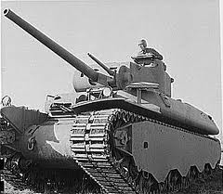
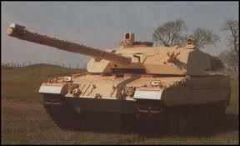
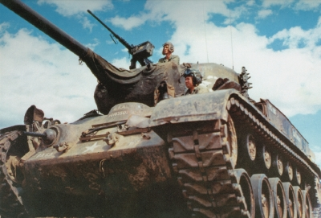
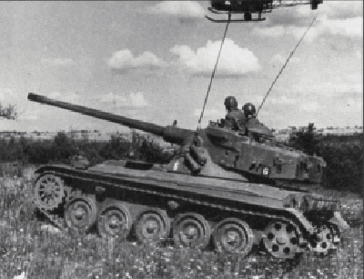
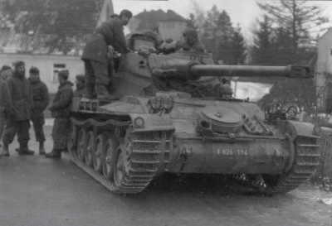
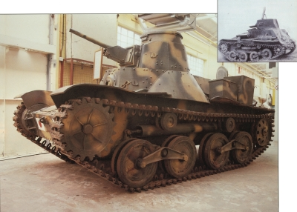
Types Inventions
Heavy Tanks-
Light Tanks-

Slide 15
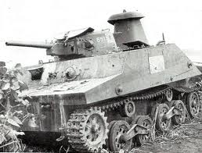
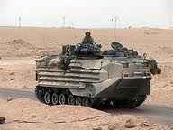
Types of Inventions
M1 tank
water tank

Slide 16
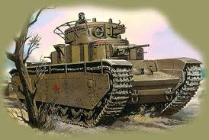
Types Inventions
Heavy tank
light tank

Slide 17
Technology of Invention
To Create a armored device that is able to get into and over enemy lines without being injured, hurt, shot, etc. and doesn’t have the disadvantage of running out of ammo faster to take out enemies than a regular average gun and dying in the line of fire.

Slide 18
Technology of Invention
Canons ,guns ,and scopes and heavy duty protection.

Slide 19
Overview of the Creation
Example | Science | Technology | Engineering | Math
Tank | The discovery and need of a armored device to cross over ground, dirt, mud, snow and the science of metal and the materials used to make it for armor | Having a armored device that doesn’t have the failure of being able to cross into enemy lines | Designing a armored device with parts including bulletproof armor, guns, caterpillar tracks, to be together on one object | Size, length, width of Tank or shape inside and outside of the armored device

Slide 20
Overview of the Creation
Example | Science | Technology | Engineering | Math
tank | discovery of a tractor that’s what it was before | creating something to help the united states win wars | designing a weapon that can help us win wars | How big the barrel and gun had to be plus the size of the hole thing

Slide 21
Positive Impact of Invention
It helps the army stay safer and equipped in a battle
It Gives us better chances to win a battle or in combat
It allows us to reach our goal such as going into enemy lines without getting hurt
It Strengths our defense between other countries and other armies

Slide 22
Negative impact on Society
The Negative impact of the Tank is that the government spends lots of money to get tanks produced and that hurts the government and also other countries could make their own tanks to use against anyone which would cause more rage leading to more violent battles.

Slide 23
Positive Impact of Invention
Helps win wars
helps protect solders
transpiration
Helps reach our goal

Slide 24
Negative impact on Society
Takes up a lot of gas

Slide 25
Resources
http://science.howstuffworks.com/m1-tank1.htm
http://science.howstuffworks.com/enlarge-image.htm?terms=tank+-thomas&gallery=1&page=22
http://science.howstuffworks.com/m-26-general-pershing-heavy-tank2.htm
http://www.historywiz.org/tank.htm
http://www.brainyquote.com/quotes/keywords/tanks.html
http://mailer.fsu.edu/~akirk/tanks/UnitedStates/heavytanks/HeavyTanks.html
http://www.firstworldwar.com/weaponry/tanks.htm
http://science.howstuffworks.com/m1-tank2.htm
http://science.howstuffworks.com/m1-tank1.htm
http://science.howstuffworks.com/m1-tank3.htm
http://mailer.fsu.edu/~akirk/tanks/UnitedStates/heavytanks/HeavyTanks.html
http://www.militaryfactory.com/armor/light-tanks.asp
http://science.howstuffworks.com/amx-13-light-tank.htm

Slide 26
Resources
http://www.militaryphotos.net/forums/showthread.php?6515-Old-tanks-in-spain.
http://www.historywiz.org/tank.htm
http://www.brainyquote.com/quotes/keywords/tanks.html
http://mailer.fsu.edu/~akirk/tanks/UnitedStates/heavytanks/HeavyTanks.html
http://www.firstworldwar.com/weaponry/tanks.htm
http://science.howstuffworks.com/m1-tank2.htm
http://science.howstuffworks.com/m1-tank1.htm
http://science.howstuffworks.com/m1-tank3.htm
http://mailer.fsu.edu/~akirk/tanks/UnitedStates/heavytanks/HeavyTanks.html
http://www.militaryfactory.com/armor/light-tanks.asp
http://science.howstuffworks.com/amx-13-light-tank.htm

