Slide 1
Technology Investigation
By: Chastin Evans and Johnny Rios
Body Armor
GTT Project 1.1.3a

Slide 2
Purpose: to protect the body from any threatening material or dangerous situation, for example like getting stabbed with sword.
Main function: to save peoples lives and to protect body parts from lethal weapons, like bullets or swords
Purpose and Main function

Slide 3
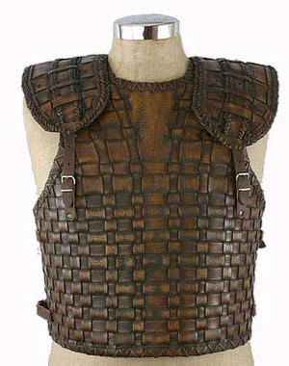
History
Japans natives
No exact date
Made of fine silk, and leather, and
Made of fine silk, and leather, and lowered your chances of getting cuts or wombs from swords
Notes:
History

Slide 4
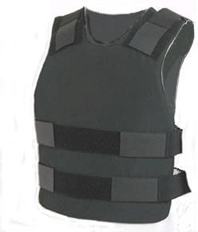
Original vs Today
Original: the original was from Japan made out of silk and leather and could hold up farley well against swords.
Today: today's body armor is made out of Kevlar and is used to stop bullets.

Slide 5
Quote about the Invention
Quote: “the military's own report says that one-third of deaths and casualties could have been avoided if proper body armor and vehicle armor had been provided from the start of the war.”
John Oliver

Slide 6
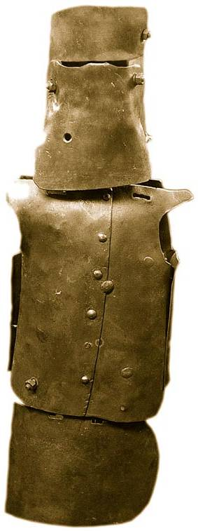
Innovations for improvement
One innovations is the chain mail witch could block a swipe from a sword.
After the innovation of the Colt the armor took a down fall until an the Kelly gang made a iron suet that could stop a bullet.

Slide 7
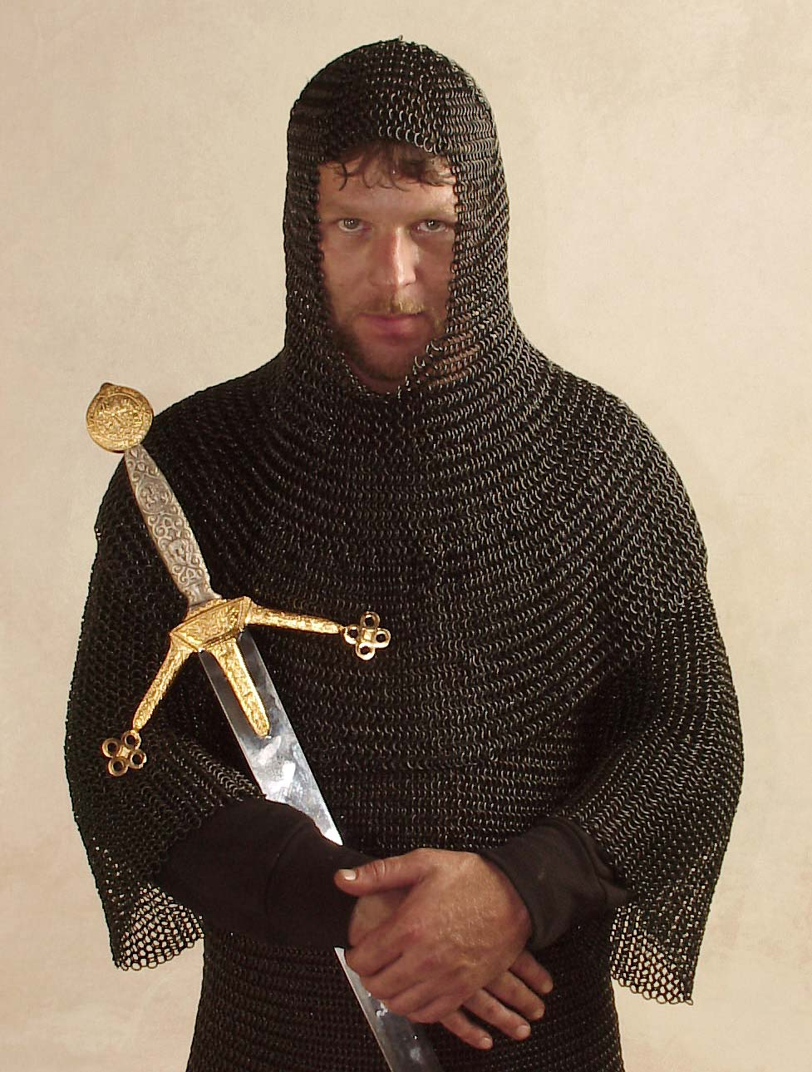
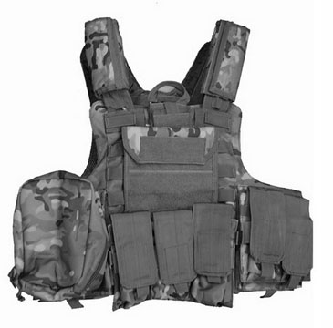
Types of Inventions
Kevlar
chain mail
Dragon skin

Slide 9
Technology of Invention
What materials should they use for the body armor .

Slide 10
Overview of the Creation
Example | Science | Technology | Engineering | Math
body armor | What weapons can the material protect against | what material to use | how to put the armor together | the dimension Of the body armor

Slide 11
Positive Impact of Invention
Police are able to do their job more efficiently.
It has caused less death and grief at war

Slide 12
Negative impact on Society
Criminals, outlaws and enemies in general can use body armor too.

Slide 13
Resources
Global Security. org
enchanted learning: inventions
Brain quotes
history of body armor and bullet proof vests

Slide 14
Technology Investigation
By: chastin and Johnny
Body Armor
GTT Project 1.1.3a

Slide 15
History
Main Functions
to save lives and protect body parts.
Purpose
To protect the body from any threatening material or dangerous situations.

Slide 16
Original inventor
It was first made in Japan, no exact recorded date or single inventor.
It was made out of fine silk and leather and then upgraded over time.

Slide 17
Original vs. Today
Original : the original was from Japan ,made out of fine silk and leather and wasn’t very effective.
Today: today's body armor is bullet proof, made out of material called Kevlar. it is called the Kevlar vest and very effective.

Slide 18
Quote about the Invention
Quote: “

Slide 19
Innovations for improvement
Better material for better protection.
fairly lighter.

Slide 20
Types of Inventions

Slide 21
Types Inventions

Slide 22
Technology of Invention

Slide 23
Overview of the Creation
Example | Science | Technology | Engineering | Math

Slide 24
Positive Impact of Invention
Police have been able to do their job more efficiently.
It has caused less death and grief.

Slide 25
Negative impact on Society

Slide 26
Resources
History of body armor and bullet proof vests
Enchanted Learning: Inventions

