Slide 1
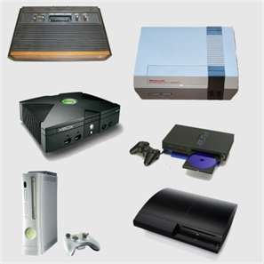
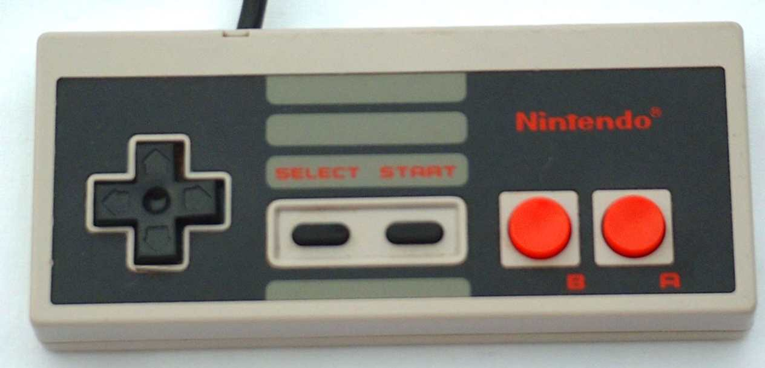
Game console
By: Dominic Johnson, Giovanni Gomez, and Harley Frank
Dominic Johnson
GTT Project 1.1.3a

Slide 2
Uses
Main Functions
Used in MLG (Major League Gaming)and tournaments.
Used for educational purposes.
Can play music on Xbox 360.
Watch movies such as Netflix.
Go on internet.
To entertain yourself, and to have fun.

Slide 3
History
Ralph Baer was the first person to play the first video game console.
The game console has gotten very small. It has been as big a CP but it now is as big a XBOX 360 controller or a PS3 controller.
It was just a joint stick and a screen but it is now a whole system.

Slide 4
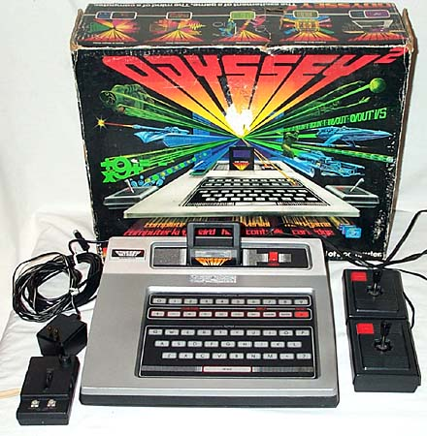
Who invented the odyssey and when was the odyssey invented?
Ralph Baer and Magavnox invented the first game console in 1972.
The name of the game console they invented is called the Odyssey.

Slide 5
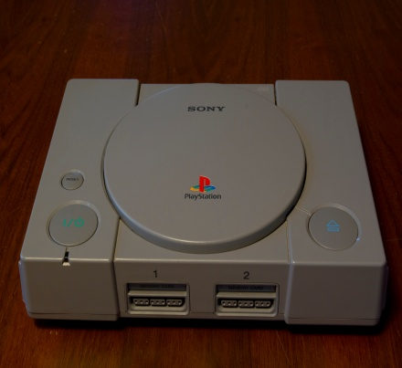
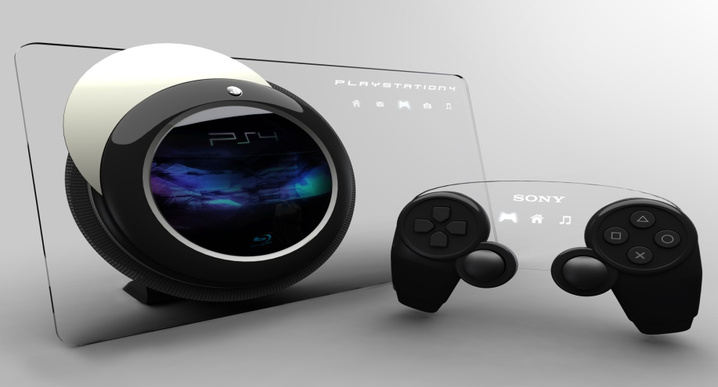
Original vs Today
Original : Used to play on a T.V for entertainment.
PS1
Today Now is used in MLG(Major League Gaming) tournaments and for fun.
PS4

Slide 6
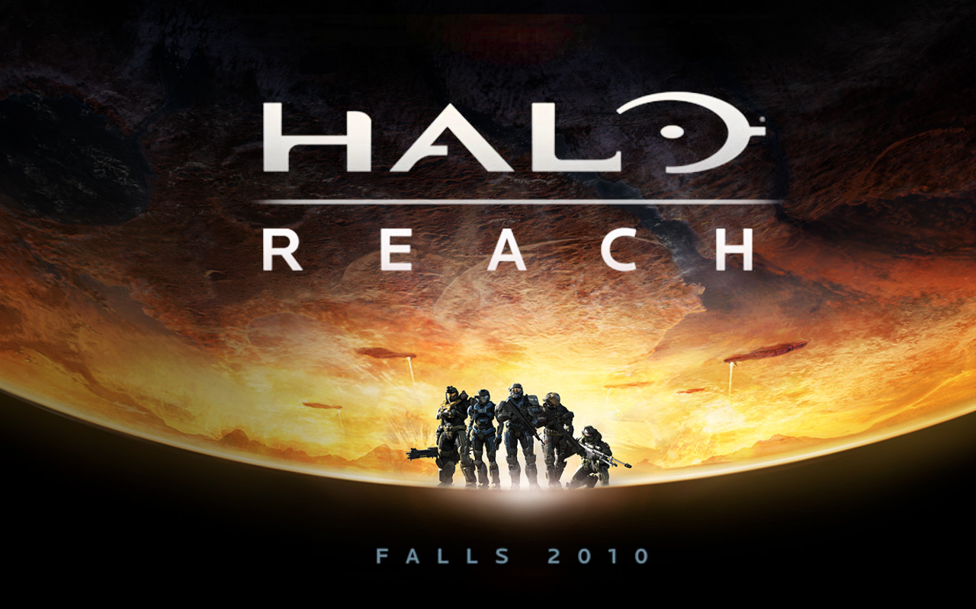
Quote about the Invention
Quote: “Halo 3 has become a pop-culture phenomenon. Not only is it setting sales records, it's also redefining entertainment. Within the first 24 hours alone, we've seen more than a million Xbox LIVE members worldwide come online to play Halo 3 - that makes 25 September the most active Xbox LIVE gaming day in history. “ Shane Kim~ Corporate vice president of Microsoft Game Studios on launch of Halo 3 on September 25, 2007. It became biggest entertainment launch in history, selling $170 in US in first 24 hours.

Slide 7
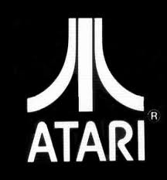
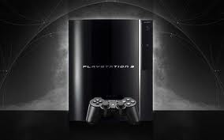
Types of Inventions
The Discs
The Game Packs
Different consoles, Examples: Xbox’s, Playstation’s, Atari's, Nintendo’s, Gameboy’s, Wii’s, PC’s.

Slide 8
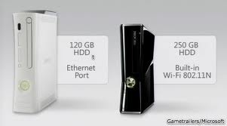
Innovations for improvement
They almost always make improvement for example:
PS1 to a PS2 then a PS3
XBOX to a XBOX 360 to XBOX 360 ELITE to a XBOX 360 SLIM
Video Game Console
Video Game Discs

Slide 9
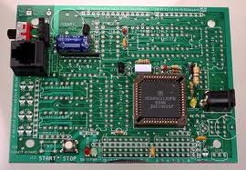
Technology of Invention
Nano technology
Information and Communication

Slide 10
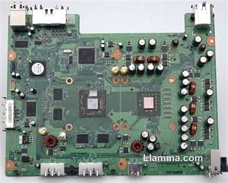
Overview of the Creation
Example | Science | Technology | Engineering | Math
Game console | Make the game work and make the discs readable so the console can read it. | Make the graphics and find out how to make the video games look realistic. | Design a console that would be able to hold memory and hold the game. | What size and shape the disk and console have to be.

Slide 11
Positive Impact of Invention
Kids entertain themselves when there parents are doing important stuff.
Video games give your child's brain a real work out. It involves high level thinking.
The player learn to manage resources that are limited, and decide the best use of resources, the same way as in real life.
Many games are played online and involve cooperation with other online players in order to win.

Slide 12
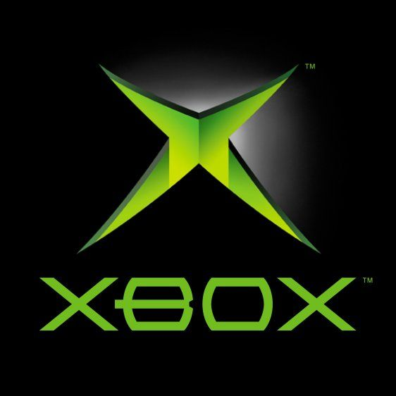
Negative impact on Society
Games can confuse reality and fantasy.
Too much video game playing makes your kid socially isolated. Also, he may spend less time in other activities such as doing homework, reading, sports, and interacting with the family and friends.

Slide 13
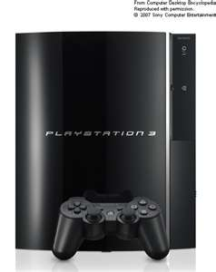
Resources
www.trueknowledge.com
www.honda-tech.com
http://www.ibspro.net/tag/console
http://www.raisesmartkid.com/3-to-6-years-old/4-articles/34-the-good-and-bad-effects-of-video-games
http://www.bing.com/images/search?q=game+console&view=detail&id=8F010B62C1C36B8D707B8D301D092BA3261E8B83&first=0&FORM=IDFRIR
http://www.bing.com/images/search?q=game+consoles&qs=n&sk=&sc=8-13&form=QBIR

Slide 14
Resources
http://1.bp.blogspot.com/-pqXCf4CqQAE/Ta1guiOIWzI/AAAAAAAAA2c/stKJPXpiavs/s1600/magnavox_odyssey2.jpg
http://blog.theplaydiumstore.com/wp-content/uploads/2011/03/GameConsoles.png
http://atomictoasters.com/wp-content/uploads/2010/12/nintendo-pad2.jpg
http://upload.wikimedia.org/wikipedia/commons/b/b6/Playstation_image.jpg
http://i5.photobucket.com/albums/y160/myshoppics/CoolThing.png

