Slide 1

Technology Investigation
By: Joshua and Kori
Cell Phone
GTT Project 1.1.3a

Slide 2
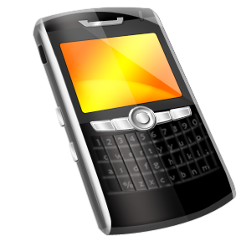
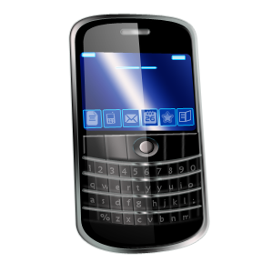
History
Purpose: Its purpose is to communicate with others through many things ( email, text, etc…).
Did you know: that Alexander graham bell was a Scottish American?

Slide 3
History
Did you know: the word telephone in Greek means “far sound”.
Purpose: its purpose is to call other people’s phone’s through texts and emergency calls

Slide 4
Details
Inventor and date: Alexander Graham bell is the inventor, 1847-1922
Invention details: the electro magnet in the ear piece turn sound waves into understandable speech.

Slide 5
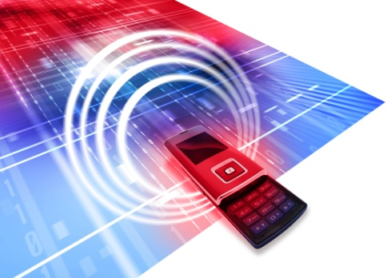

Original vs. Today
Original :the original telephone was called the telegraph.
  Did you know: the first working telephone was experimented in 1956 and could carry a signal 2,200 miles between many countries.
Today the telephone is now much more compact and can call and carry signals over 2,200 miles and now uses satellite technology to carry signals instead of electricity wires

Slide 6
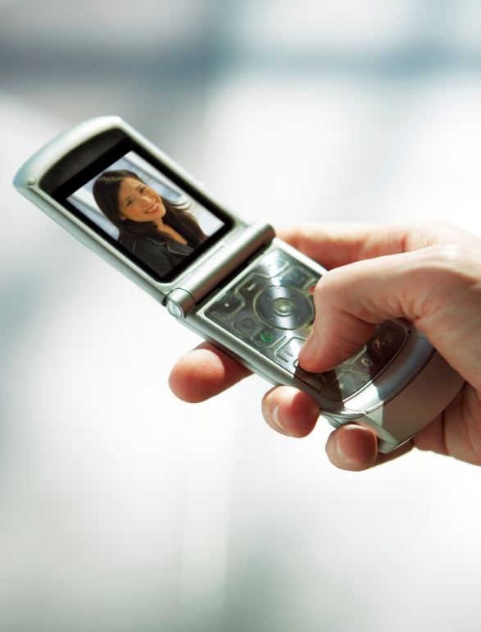

Quote about the Invention
Quote: and some quotes about the telephone were from CBS news saying "one in four house holds have cell phones but no traditional land lines.”

Slide 7

Innovations for improvement
The black berry
: the telegraph
: The phonograph

Slide 8
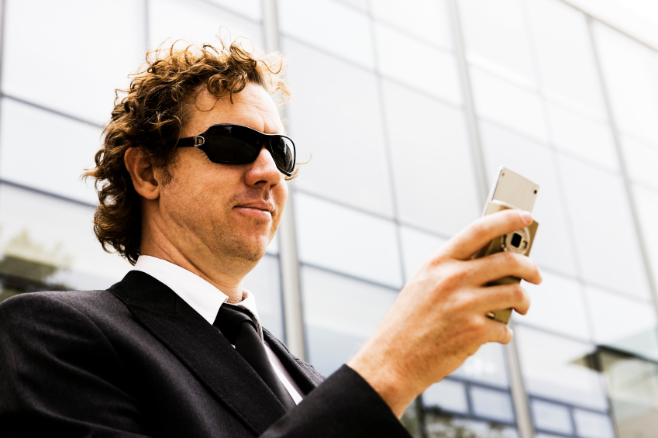
Types of Inventions
the I Pad would be one of the inventions
as would the Black Berry.

Slide 9
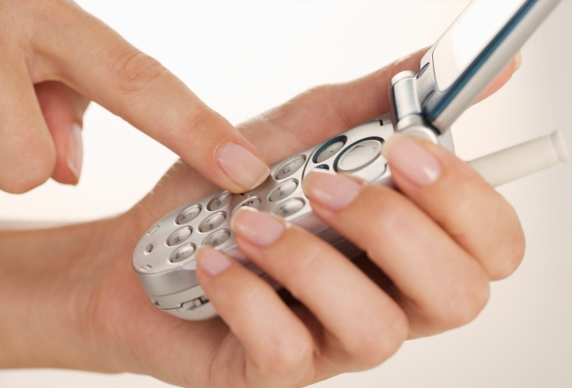
Types Inventions
And a gps because with out the telegraph there would be no phone.
and last but not least the I Phone

Slide 10
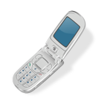
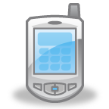
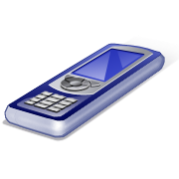
Technology of Invention
some of the components of the telephone are the switch hook that allows the person to receive a call. Also the dialer and the ringer.

Slide 11
Overview of the Creation
Example | Science | Technology | Engineering | Math
telephone | trying to turn electricity into sound waves | the microphone hast to turn sound into electricity waves and the speaker turns it back into sound waves | is making the electro circuit and the micro processer so the phone can actually function properly. | the math behind the phone is telling how big the electro-circuitry and the micro processor,-speaker and microphone should be.

Slide 12
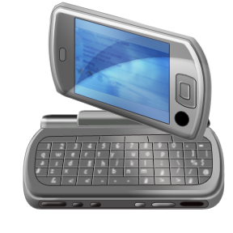
Positive Impact of Invention
Instead of delivering messages in person you can do it easily at home.
it sent messages faster.
it is much more efficient.
it takes not as much energy.

Slide 13
Negative impact on Society
The negative impact on society is that it cost much more because the materials needed were hard to get and that cost money and because it was a new object it was fairly big and was not as compact as modern today so it took more for manufacturing and that costs money.

Slide 14

Resources
www.History.com
www.How Stuff Works.com
www.Discovery.com
www.CBSnews.com

